Slide 1

Search for a SM Higgs Boson in the LHC with the CMS experiment using the H → WW → 2µ2ν decay channel
Memoria de tesis presentada por Rebeca Gonzalez Suarez
para optar al grado de Doctor, dirigida por
Dr. Javier Cuevas y Dr. Teresa Rodrigo
Santander, 9 de Septiembre de 2010

Slide 2
Introduction
This presentation reviews my PhD work on the prospective search of a Standard Model Higgs boson in the LHC with the CMS experiment
Monte Carlo based study for different scenarios
Completed with dedicated methods to estimate the main backgrounds from data and the systematic uncertainties
Main physics observables as well some of the backgrounds are already being studied with data
The Higgs decay channel to two W bosons can allow for the study of the Higgs mass region not yet completely covered by the Tevatron, already in the first run at 7 TeV

Slide 3
Outline
The Standard Model
Higgs Boson
Large Hadron Collider
CMS experiment
Search Strategy
Physical Observables
Analysis Flow
Methods to estimate background from data
Systematics
Results
Conclusions

Slide 4
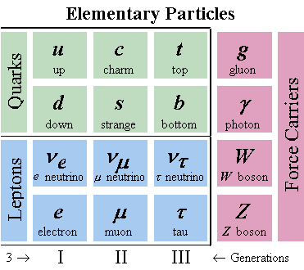
The Standard Model
The Standard Model (SM) of Particle Physics describes the fundamental interactions between the elementary particles that compose matter
The constituents of known matter (leptons and quarks, fermions) interact through:
electro-magnetic force: photons (γ)
weak force: W, Z
strong force: gluons (g)
The SM its in very good agreement with most of experimental data up to now, but still some aspects are uncovered

Slide 5
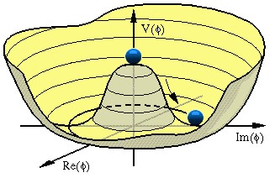
The Higgs Mechanism
One of the most important open questions of contemporary particle physics:
Reveal the physical mechanism responsible for the breaking of electroweak symmetry , responsible for the masses of the particles and not explained by the SM
To solve this, a simple mechanism can be incorporated to the SM
→ Higgs Mechanism
It leaves the Standard Model mostly untouched, but…
Adds one additional scalar boson, whose mass is a free parameter of the theory and has to be detected:
the Higgs boson
There are many other proposed mechanism (multiple higgses, technicolor…) but my PhD work was focused in SM Higgs

Slide 6
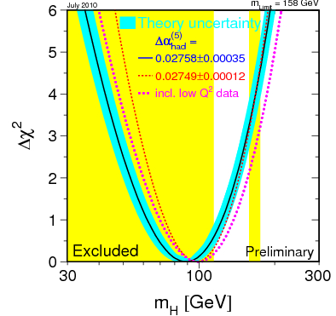
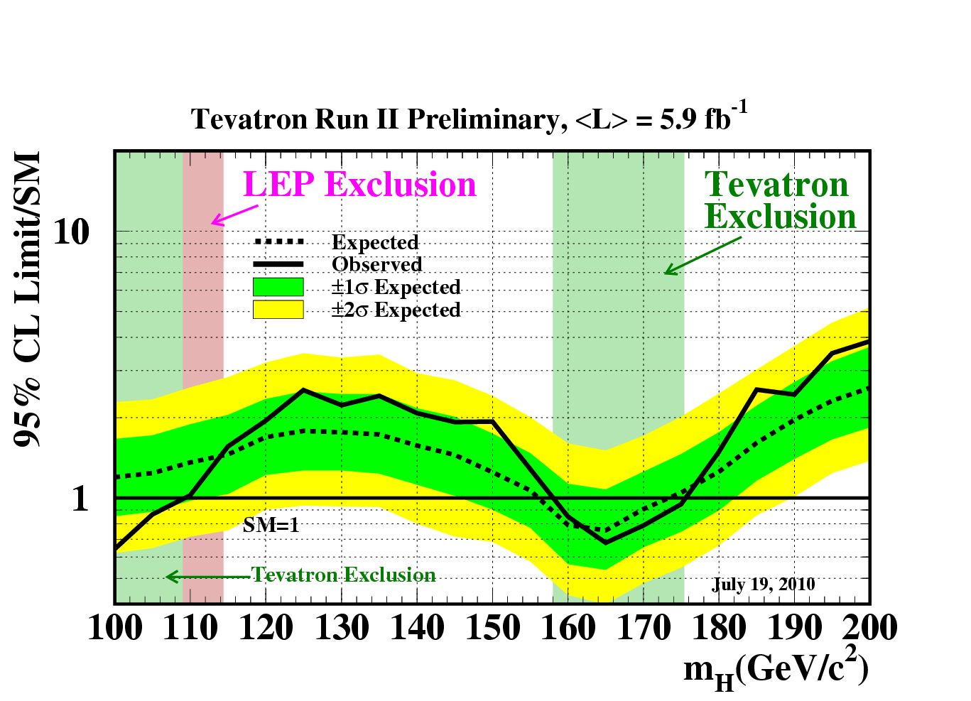
Previous and Current Higgs Searches
Direct and indirect measures
LEP set a 95% CL lower limit of m_{H} ≥ 114.4 GeV/c²
The precision electroweak measurements tell that the mass of the Standard-Model Higgs boson should be lower than ~158 GeV/c²
The limit increases to 185 GeV/c² when including LEP-2 data
The Tevatron experiments CDF and DØ also search for the Standard-Model Higgs boson; the most recent combined result excludes the mass range between 158 and 175 GeV/c², and between 100 and 109 GeV/c² at 95% CL

Slide 7
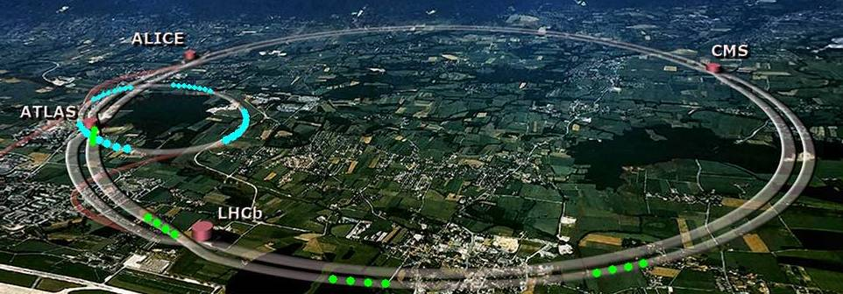
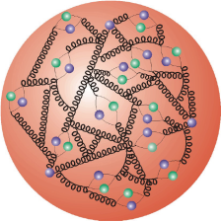
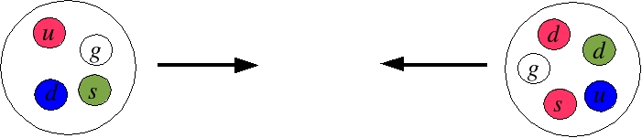
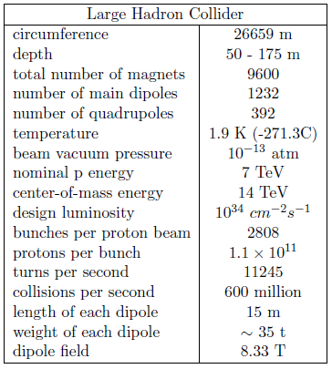
The Large Hadron Collider
The Large Hadron Collider (LHC) the largest and highest-energy particle accelerator of the world, located at CERN (Geneva, Switzerland)
It is operating at a proton-proton collision energy of 7 TeV (3.5 TeV each beam) since March
The design collision energy 14 TeV will be reached in the future
The magnetic field is created by 1232 superconducting dipole magnets
It has 4 big experiments (ALICE, ATLAS, CMS, LHCb), two of them (CMS and ATLAS) are intended for general purposes and complementary

Slide 8
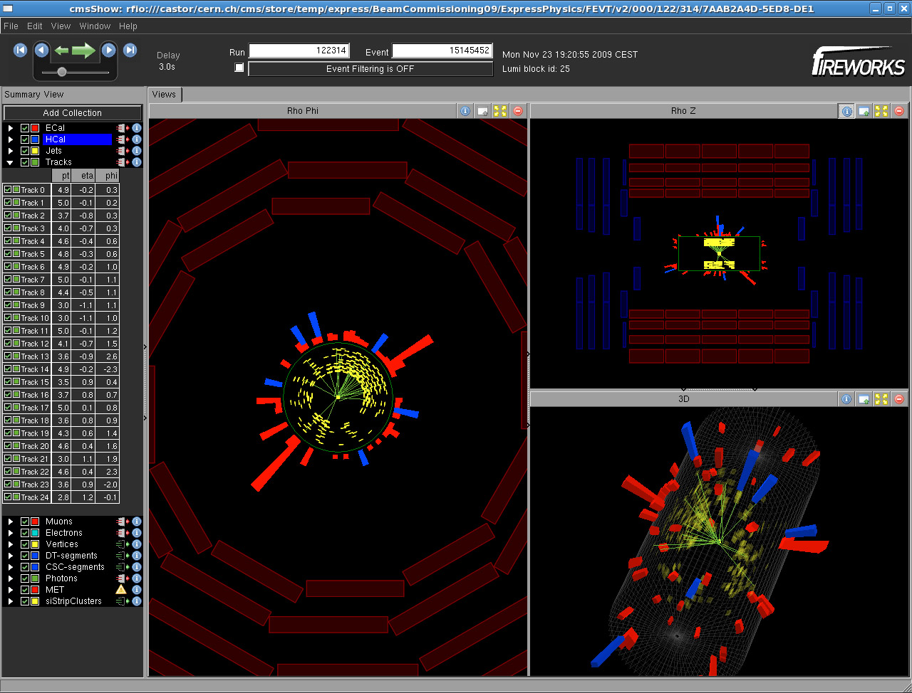
First Collision Event Recorded at CMS

Slide 9
LHC timeline
1981: - The design of the LHC starts
1994: - Project approved by CERN Council (Dec.)
…. Building, Assembling, Commisionning …..
2007: - Physics Analysis ready for a 14 TeV start-up (public)
2008: - First proton beams circulating at the LHC (Sept. 10)
2009: - Chamonix: possible new scenario 200pb⁻¹ at 10 TeV (Jan.)
- Projections for 10 TeV (public), full analysis at 10 TeV
- Clockwise circulating beam established again (Nov. 20)
- Two beams simultaneously for the first time, first chance
for proton-proton collisions at 900 GeV (Nov. 23)
- The LHC became the highest energy accelerator of the world with
2.36 TeV, beam energy of 1.18 TeV (Nov. 30)
2010: - Chamonix: denitive first run conditions, 7 TeV, 1 fb⁻¹ by end of 2011 (Jan.)
- Projections for 7 TeV (public), full analysis at 7 TeV
- 3.5 TeV each beam (March 19)
- First 7TeV collisions (March 30)

Slide 10
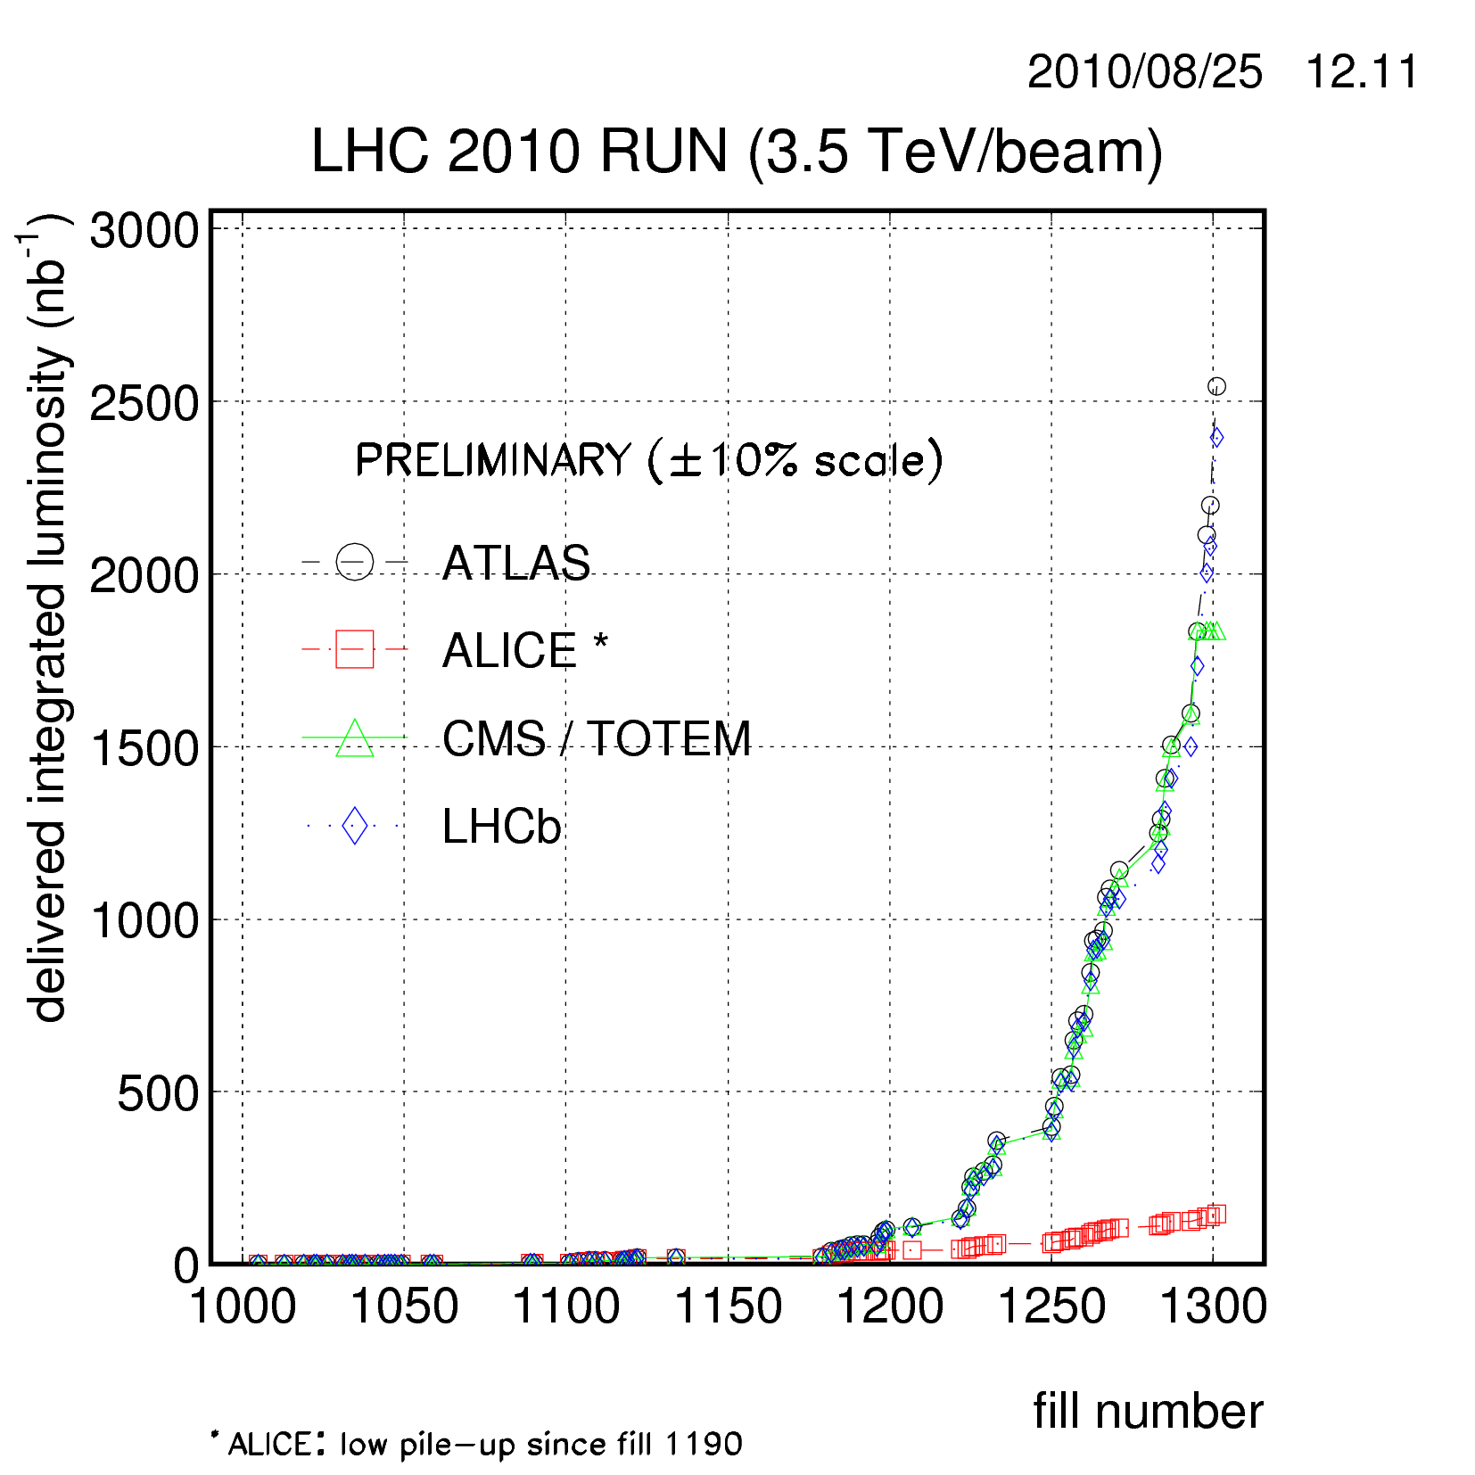
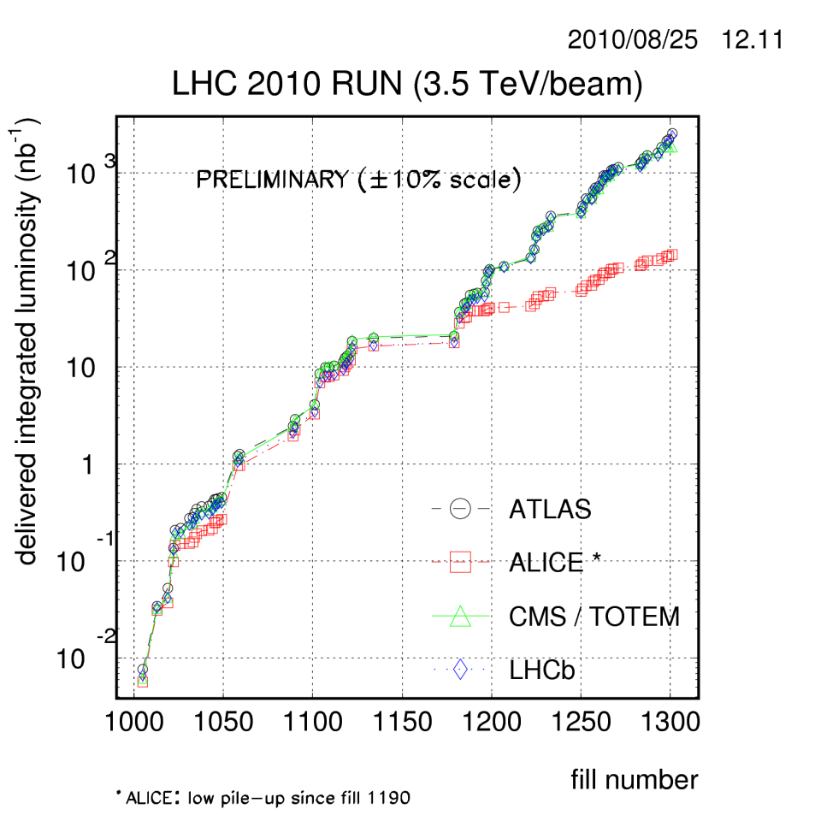
LHC current status
Integrated luminosity delivered, in STABLE BEAMS
Amongst the parameters to be improved, the only still far away from a “realistic 2011 target” is the number of bunches, and to increase it is the main priority

Slide 11
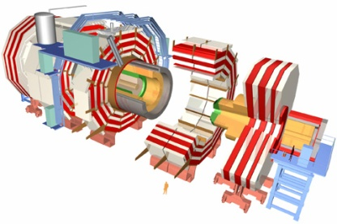
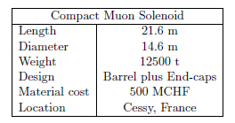
The Compact Muon Solenoid
CMS is, with ATLAS one of the two main general purpose LHC experiments
CMS stands for Compact Muon Solenoid
Compact
“Small” in size when compared to ATLAS, but two times heavier
Muon
Optimized for Muon detection
Solenoid
Magnetic field produced by a superconducting solenoid
The CMS experiment is one of the largest international scientific collaborations in history
(June 2008) ~3600 people working for CMS, coming from 183 institutes in 38 countries
The excavations to place the CMS cavern started in1998, but the latest part of it was lowered in January 2008

Slide 12
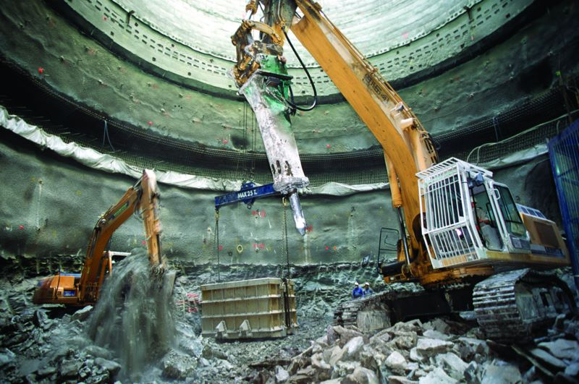
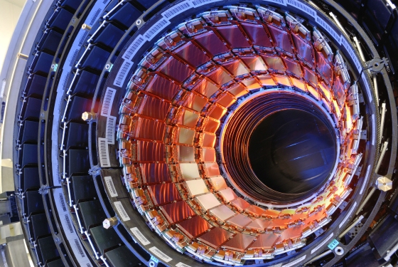
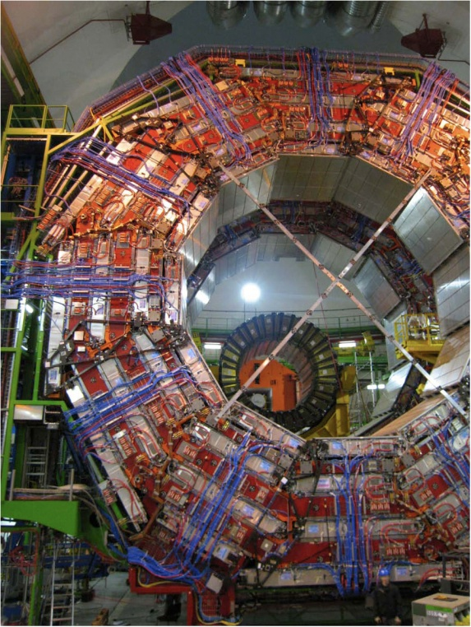
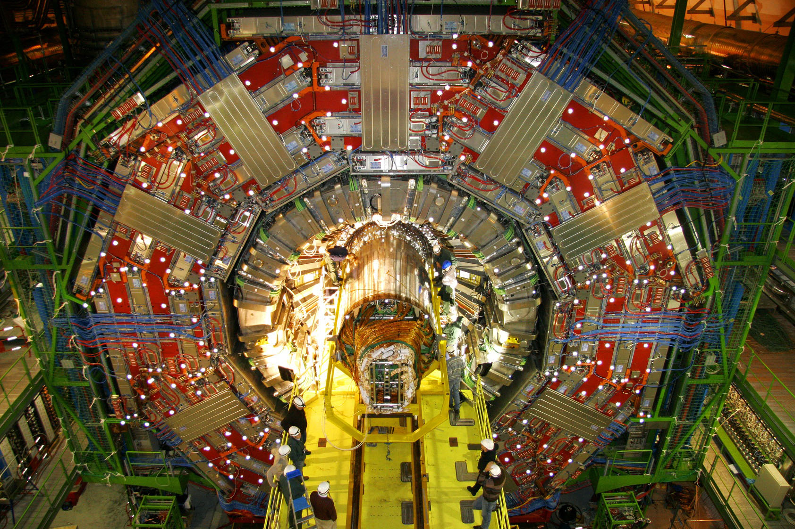
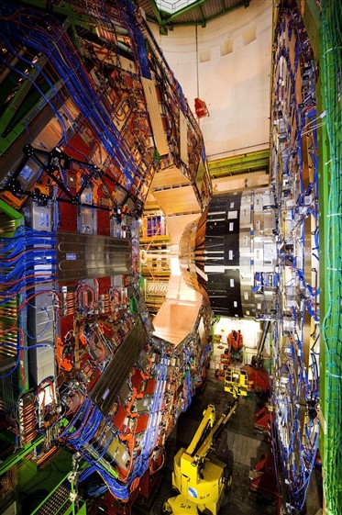
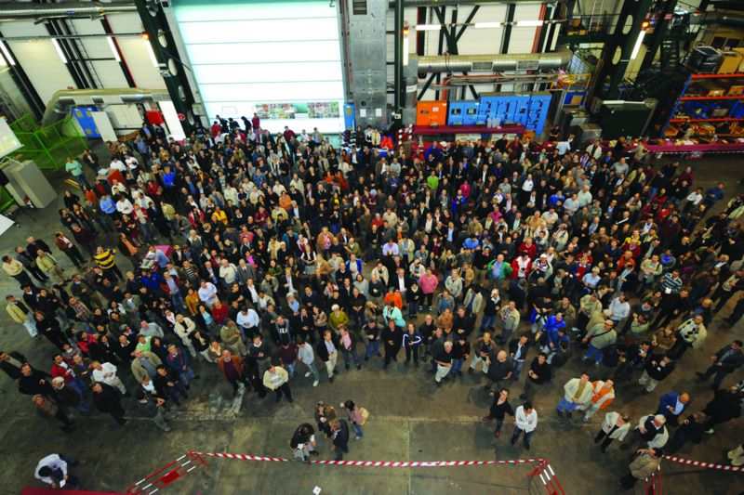
Some pictures of the different stages of CMS

Slide 13
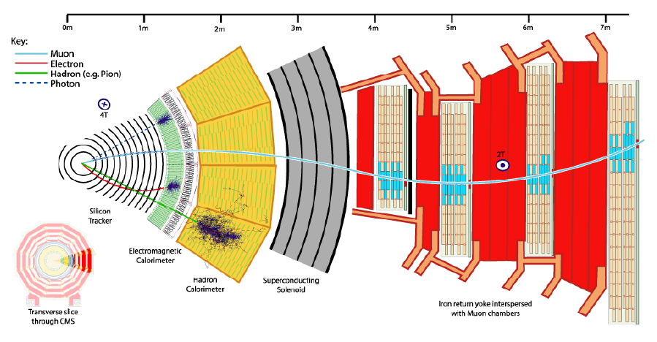
The CMS detectors
Tracker
Charged Particles
Superconducting solenoid
Electromagnetic Calorimeter
(ECAL)
Electrons and photons
Hadronic Calorimeter (HCAL)
Hadrons
Protons, neutrons, pions, kaons…
Jet/MET measurements
Muon System
Identify muons
Measure Pt
Trigger
Drift tubes (DT)
Cathode Strip Chambers (CSC)
Resistive Plate Chambers (RPCs)

Slide 14
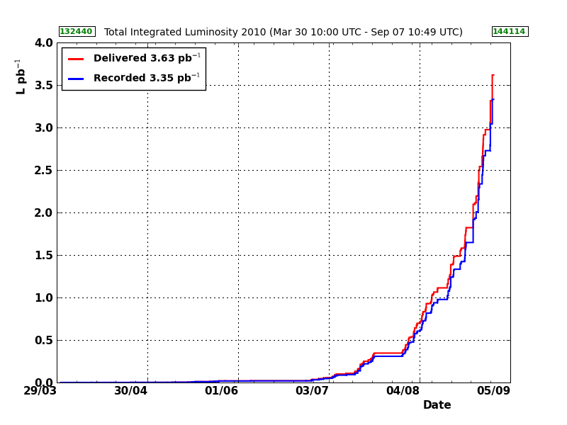
CMS Current status
Already more than 3pb⁻¹ of 7 TeV data recorded by CMS
Data taking efficiency of ~93%
The operational status sub-dectectors is > 98%
Continuosly improving

Slide 15
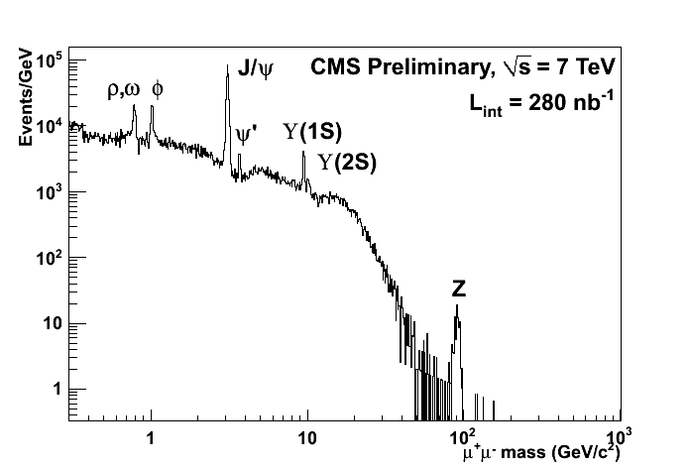
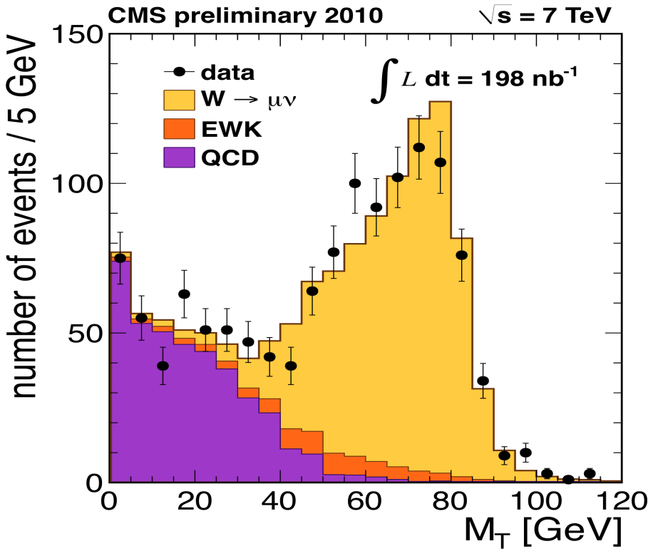
CMS First Physics
With less that 1pb⁻¹ CMS was able to produce an impressive catalog of results
Starting from Minimum bias, QCD studies
J/ψ, Υ observation
And the first EWK measurements of W and Z
The main physics observables used in the work presented here have been already validated in data (Muons, Missing E_{T} and jets) showing an excellent performance

Slide 16
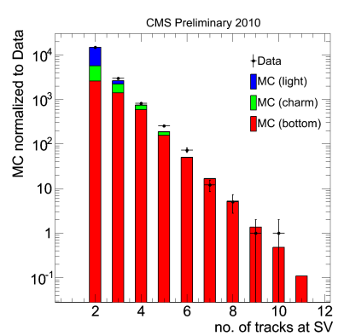
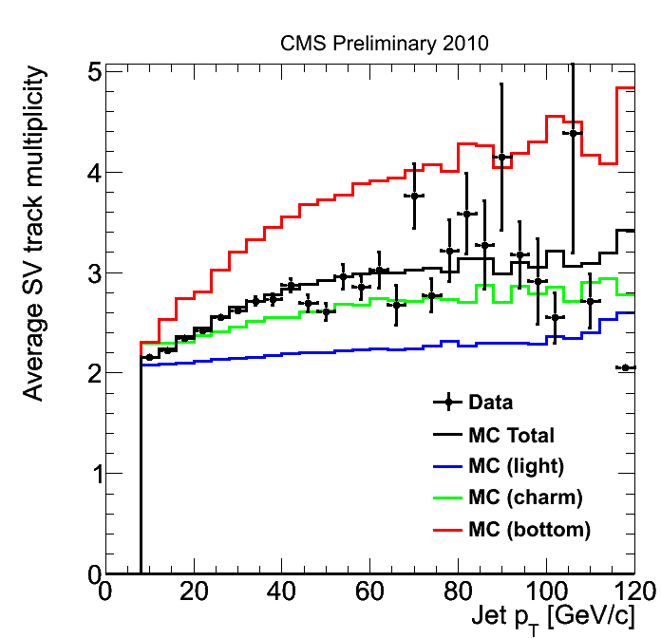
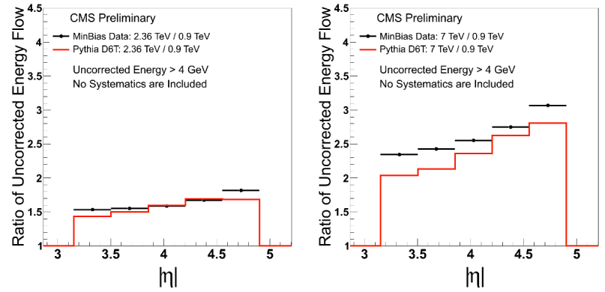
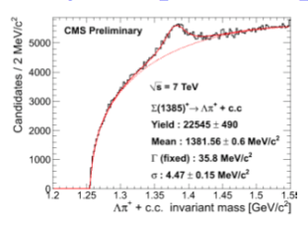
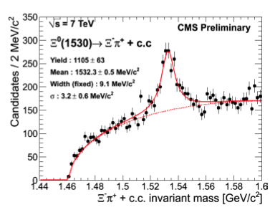
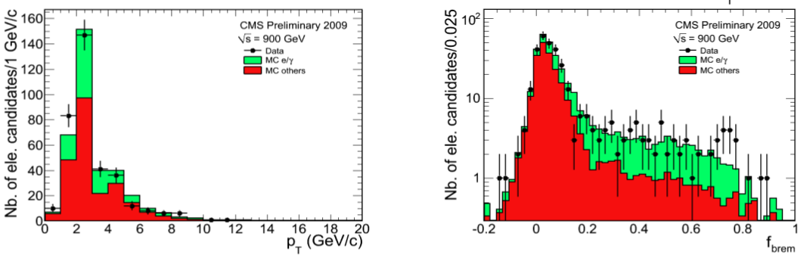
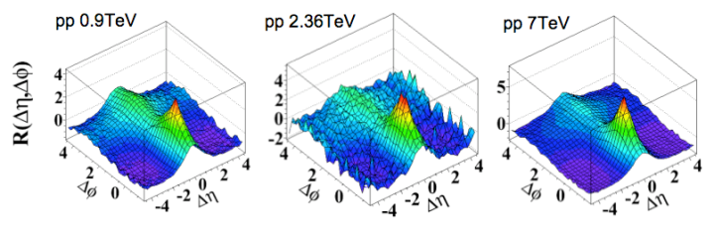
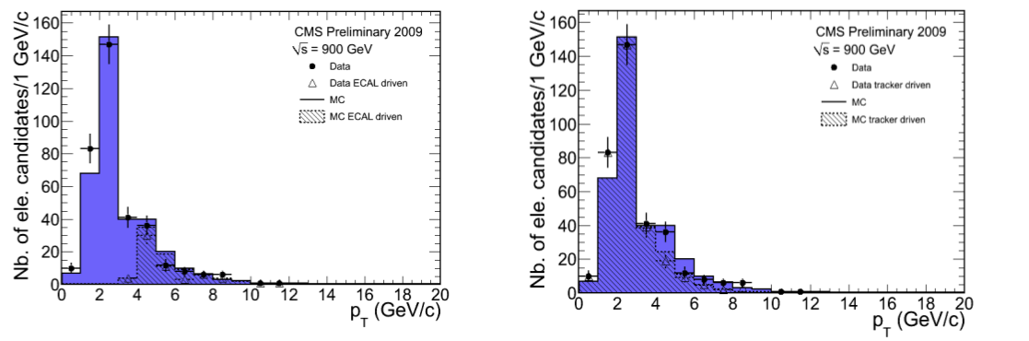
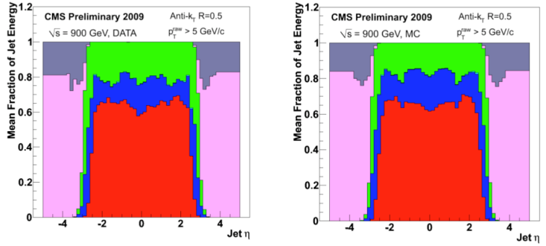
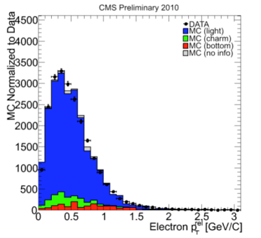
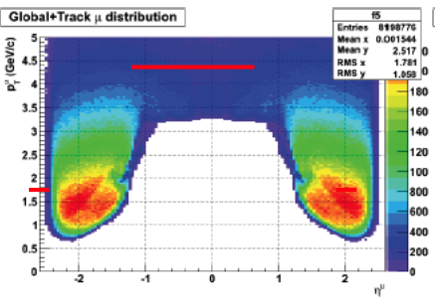
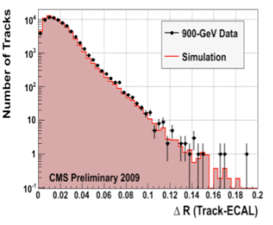
Many more results

Slide 17
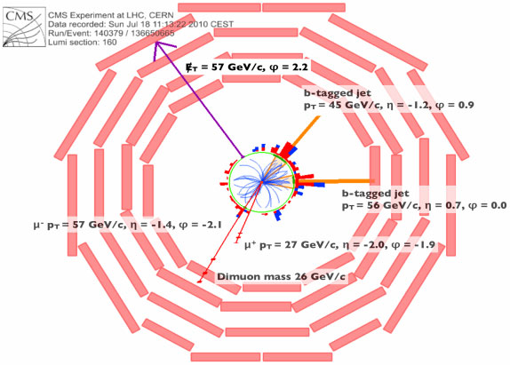
And the next step
In around 6 months of running at 7 TeV top events have already been recorded
Top Physics are already round the corner
First Golden top dilepton candidate in CMS (July):
2 Muons, 2 b-tagged jets, Missing E_{T} compatible with expected

Slide 18
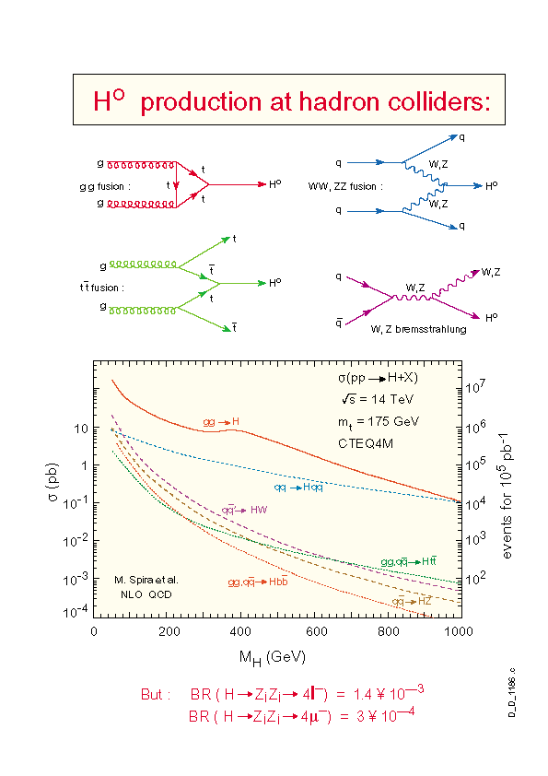
Search for a SM Higgs at the LHC: Production
The Search Strategy for a particular Higgs mass hypothesis → determined by the production mode and decay channel
Main production modes Vs Higgs mass at the LHC
Gluon-gluon fusion (ggH):
Dominant production mode
Vector Boson Fusion, VBF (qqH):
Characteristic signature with two forward jets and rapidity gap, increasingly important for high masses
Associated production (WH, ZH, ttH): Relevant in the low mass region, allows for ‘easy’ triggering

Slide 19
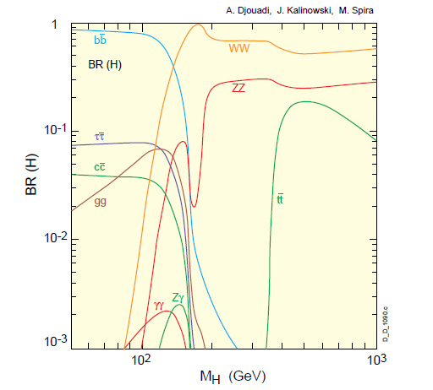
Search for a SM Higgs at the LHC: Decay modes
Low mass (m_{H}< 2m_{Z})
H→bb: Highest BR for low masses. Challenging experimentally, huge QCD background
H→ττ: Collinear approx.→mass reco. Accesible through VBF
H→γγ: Mass-peak with good resolution
H→WW: Earliest sensitivity
H→ZZ: Very clean experimental signature with 4 leptons
High mass (m_{H} > 2m_{Z})
H→tt: Difficult selection

Slide 20
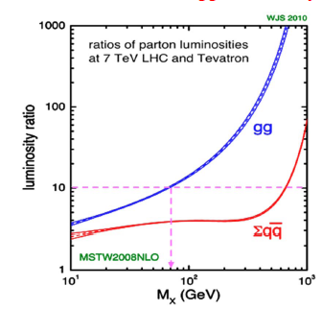
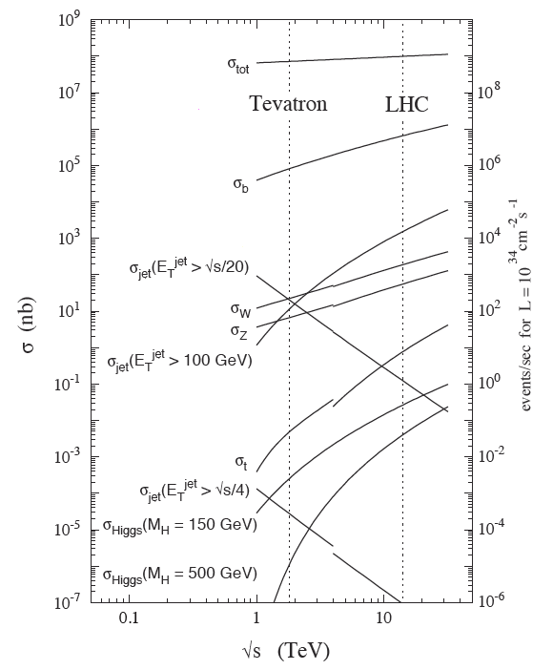
LHC Vs. Tevatron
Higgs searches at the first period of the LHC will go in paralell with the Tevatron experiments
Expectations 2011
Tevatron: 2 TeV, 10 fb⁻¹
LHC: 7 TeV, 1 fb⁻¹
And the competition wil probably go beyond 2011
At the LHC we’ll benefit from
Higher cross-sections:
More than a factor 10 for gg processes at certain masses
Better S to B:
The effect in the cross-section less pronounced for qq-induced processes, especially at high masses
Detectors optimized for Higgs searches

Slide 21
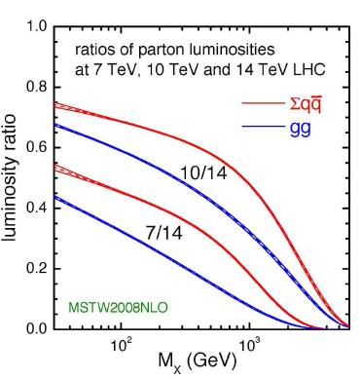
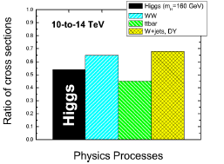
Effects from lowering the CM energy
Following 2008 incident, before the start of the current run of the LHC, several scenarios of energies and luminosities were planned
The centre of mass energy planned for the first run went from 14 TeV to 10 TeV and finally 7 TeV
Lowering the CM energy has an effect in the cross-sections that is more evident for qq events (backgrounds)
Typically, for tt (qq) the 14/7 ratio is ~5, while for Higgs (gg) m_{H}~160 GeV, the ratio is ~3.5
At smaller √s events tend to be more central, therefore, higher acceptance is expected

Slide 22
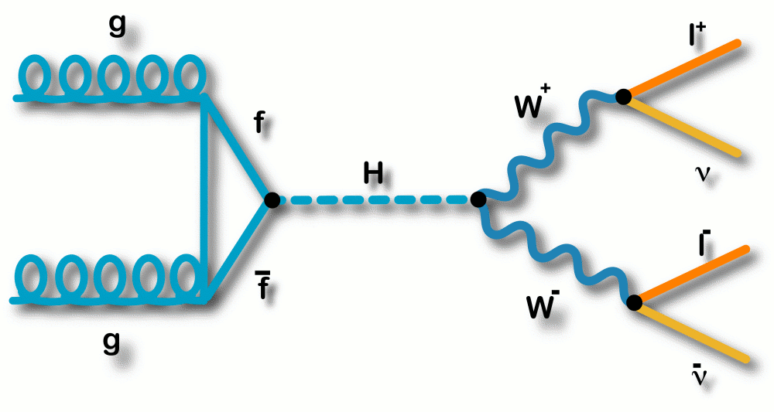
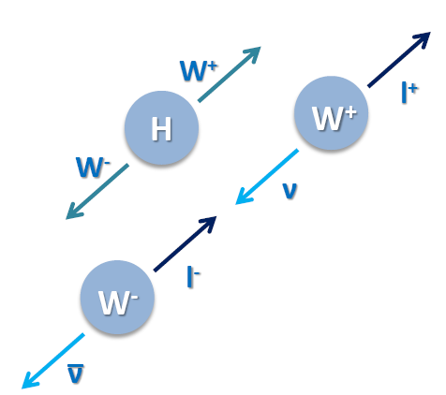
Higgs to WW*
H → WW* → 2l2ν considered the discovery channel for a SM Higgs boson in the mass range: 2m_{W} < m_{H} < 2m_{Z}
+ Branching Ratio for H → WW is close to 1 in this region (~2M_{W})
+ Leptonic final state has a clear signature
- No clear Higgs mass peak can be reconstructed
The signal is characterizad by:
Two isolated leptons (e/µ) with opposite charge and small opening angle
Missing Transverse Energy (ν)
No central jet activity
gg → H → WW* → 2µ2ν
120 ≤ mH ≤ 200 GeV/c²

Slide 23
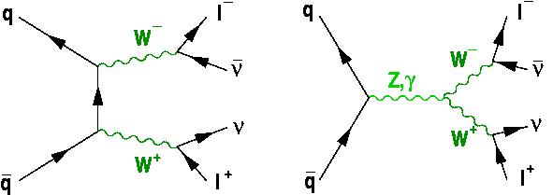
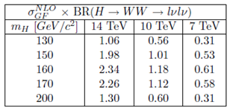
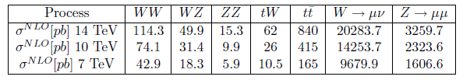
Signal and Backgrounds
Backgrounds:
All sources of real or fake multi-lepton final states + missing ET
→ ttbar (tW), WW (WZ, ZZ), W+jets, Drell-yan…
WW
Absence of the mass peak and cross-sections, orders of magnitude smaller for signal than for backgrounds → Understanding and control of the backgrounds mandatory
QCD, W+jets and Drell-Yan: easy to identify / very high cross-sections
tt can represent a problem when the hadronic content is not properly reconstructed
WW irreducible background
Signal and Background cross-sections (pb) NLO

Slide 24
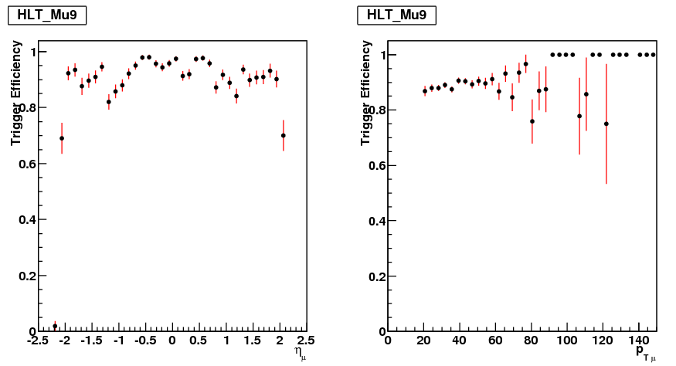
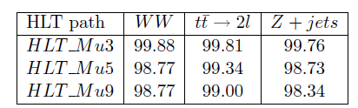
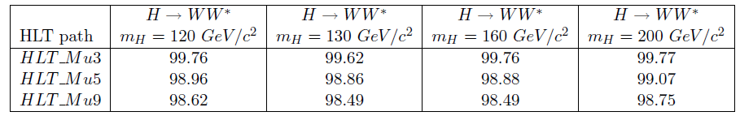
Trigger
The rate for the LHC collisions is very large
The offline system can only record a fraction
The High Level Trigger (HLT) is designed to select potentially interesting events
Trigger paths are chosen according to the characteristics of the final states considered
The analysis makes use of Muon trigger paths to selects events with muons in the final state → HLTMu9
This defines the Dataset in which the analysis will be performed in data
H → WW → µνµν (m_{H} = 130)
Efficiency ~99% signal and backgrounds
(w.r.t. to the generated within the acceptance)

Slide 25

Muons
The design of CMS is optimized for muons
They are reconstructed combines imformation from the tracker, Muon System and calorimeter information
Local Reconstruction
(hits, segments)
Tracker (Track)
Stand alone
Global
Outside in: hits and segments in the muon system (Stand alone Muon) with matched with a track in the tracker system
→ Stand alone Muon + tracker Track = Global Muon
Inside out: tracker tracks (Track) compatible with the segments in the muon system
→ Tracker Muon
Three final muon collections: Tracker, Standalone and Global (+ Calo Muons)

Slide 26


Jets
Jets are used to reconstruct the original hadronic content of the event
Several Jet Types are available in CMS with the possibility of using not only the calorimeters but all the detector:
Calorimeter Jets
(CaloJets)
Jets clustered from
ECAL and HCAL
deposits (Calo Towers)
Particle Flow Jets
(PF Jets)
coming from Particle Flow candidates
Jets plus Tracks
(JPT Jets)
Covers the space between Calo and Track Jets providing energy corrections to calorimeter jets using tracks. Replace calorimeter single particle response with tracker response
Tracker Jets
(Track Jets)
Jet reconstruction performed using only charged Tracker tracks, independent
from calorimetric measurements

Slide 27

Jets (II)
Many available Jet Clustering algorithms:
- Midpoint, Iterative and Seedless Infrared Safe Cone
- kT and Anti-kT algorithms
Default Jet Clustering Algorithm : Anti-kT with D=0.5
(infrared and collinear safe)
Calorimeter response to particles: not linear
From the measured jet energy to true particle/parton energy
Set of jet corrections for proper mapping of the measured jet energy deposition Factorized with different correction levels:
Jet corrections:
• Relative scale (L2)
– Makes response flat versus eta
– Use central jet/forward jet balancing
• Absolute scale (L3)
– Makes response flat versus pT
– Use Z/gamma + jet balancing
Default corrections
Optional corrections
• EMF corrections
– Makes response flat versus EM fraction
• Flavor corrections
– Residual correction for uds, c, b, and gluon jets
• Parton-jet corrections
– Makes response equal to parton energy

Slide 28

Missing Transverse Energy
Presence of ‘invisible’ particles → momentum imbalance in the transverse plane
There are several methods to estimate the Missing E_{T} in CMS:
Standard calorimeter
(CaloMET)
Transverse vector sum over energy deposits in uncorrected Calorimeter Towers
ECAL and HCAL
Track-corrected
(tcMET)
Improves resolution and tails
Replaces the expected energy deposition in the Calorimeters of all well reconstructed tracks by their momentum in the Tracker
← Higgs to WW to 2 muons and 2 neutrinos (signal) and Z+jets going to 2 muons ↓
Particle Flow (PFMET)
Estimated using the Particle Flow algorithm

Slide 29
Analysis Flow
Trigger
HLT paths/inital Dataset
Select potentially interesting events
Muon Selection
Central Jet Veto
Sequential cuts
Select events with two muons coming from the decay of a W boson
Skimming / Pre-selection
To reduce the size of the dataset
Veto events with jets
Additional jet requirements (e.g. track info, b-tagging)
Advanced techniques
Final analysis with sequential cuts
Counting Experiment
Multidimensional methods
(NN, BDT)

Slide 30


Muon Selection
For Muon identification different algorithms and working points are available
Events are selected if they have two reconstructed Muons:
Within the acceptance:
|η| < 2.4, and at least one of them in |η| < 2.1
Resistive Plate Chambers (RPC) cover ing both barrel and endcaps up to |η| < 2.1 Muon system up to |η| < 2.4
Carrying significant Transverse momentum:
P_{T} > 10, 20 GeV/c
Reconstructed using all the possible information:
Global Muons

Slide 31



Muon Selection II
With the following quality cuts:
- Normalized χ2 of the Global fit < 10
Powerful to reject both decays in flight and punch through, the cut is implemented in the software of CMS in the category: GlobalMuonPromptTight
Impact Paramenter value and significance:
|d0| < 2mm, |d0| / σ_{d0} < 3
Efficient for prompt muons, rejects decays in-flight and muons from b and c-quark decays
Number of valid hits used for the silicon fit: Nhits > 10
Mainly against muon produced in the decay of pions and kaons

Slide 32





Muon Isolation
The isolation is key to reject background, Muons coming from signal are expected to be isolated
The isolation variable is build in a cone of ΔR = 0.3
Iso = SumP_{T} + hadE_{T} + emE_{T}
H→WW*
QCD
Iso/P_{T} gives a better performance for low P_{T} muons
A cut on absolute isolation is imposed at higher P_{T}
Proposed isolation (black line) optimized against QCD

Slide 33

Central Jet Veto
tt → blν blν background has a high inclusive production cross-section compared with the signal
The LHC is a top-factory, @14 TeV: On the order of 840 tt will be produced for each pb ⁻¹ of luminosity
tt events are characterized by the hadronic activity
The kinematics of the tt processes slightly favors central jets, effect more pronounced at low centre of mass (CM) energy
To reduce this background in the analysis
→ Events with central jets are vetoed
Jets considered for the Central Jet Veto (CJV):
Anti-kT CaloJet, with a size of 0.5
L2 + L3 corrected
|η| < 2.5
E_{T} corrected > 30 GeV

Slide 34


Additional Strategies
After CJV, some b-quarks remain in tt events (Monte-Carlo truth)
Calorimetric Jets performance can be improved using info from the rest of detectors
Use of JPT / Particle Flow Jets: needs re-optimization
Use of the Track content of the event:
Track Jets/Number of tracks
Instead of the CaloJets or additionally
Use of b-tagging techniques:
Lifetime based algorithms
(explicit secondary vertex reconstruction, impact parameter..)
Track counting algorithms
Soft-muon: vetoing events with non-selected additional muons, potentially coming from b quarks

Slide 35



Kinematical properties used in the final selection(I)
- Angle between the muons in the transverse plane to the beam, ΔΦµµ
→ Against every background, and the only way to get rid of WW
For Higgs to WW, ΔΦµµ tends to be small due to spin correlations, while WW produces back-to-back leptons with large ΔΦµµ
Displays of Monte Carlo HWW (left) and WW (right) events, where the difference in ΔΦµµ is evident

Slide 36


Kinematical properties used in the final selection(II)
Invariant mass of the muon pair mµµ
→ Against background coming from Z
Missing E_{T}
→ Against backgrounds with no genuine Missing ET (Zµµ)
P_{T} of the muons
→ different kinematics for signal and backgrounds

Slide 37



Optimization of the cuts
Initially one set of cuts for the whole mass range
The kinematics of the event change significantly as a function of the mass
(and the CM energy)
Mass dependent optimization maximizing the statistical significance
35%
mH | MET > | ΔΦµµ (deg) < | PT max | PT min >
130 | 44 | 69 | [28, 48] | 10
160 | 48 | 57 | [28, 50] | 25
200 | 55 | 57 | [36,70] | 25

Slide 38




Distributions of the variables of the analysis
Distributions after the jet veto, 1 fb⁻¹ of integrated
luminosity at 7 TeV assumed
HWW (m_{H} =160 GeV/c2)
tW
tt
W+jets
ZZ
WZ
WW
Z+jets

Slide 39

Signal and backgrounds yields
Adapting to the changing running conditions of the LHC
Several studies carried out with different CM energies and integrated Luminosity scenarios
14, 10 and 7 TeV, from 1-3 fb⁻¹ to ~200pb⁻¹
Many improvements were made in the software, in the reconstruction and estimation of the different physics objects used in the analysis
Expected signal and background yields after all cuts
1fb⁻¹ @14 TeV

Slide 40


Signal and background yields (II)
1fb⁻¹ @ 10 TeV
1fb⁻¹ @ 7 TeV

Slide 41


Additional Strategies
To improve sensitivity specially in the low mass region
Multivariate analysis based on a Boosted Decision Tree (BDT)
Additional variables are included in order to use all the discrimination power
Two BDTs are trained, against WW and tt alone, optimized separately
Bi-dimensional approach
Single function made with the BDTs combined together
A circular cut around the region with highest signal content (center and radius chosen to optimize the signicance), Radius: final discriminating variable
Final BDT 2D discriminating variable for m_{H}=160 GeV
200 pb⁻¹ at 10 TeV

Slide 42


Methods to estimate the Background from Data
The estimation of the main backgrounds will require dedicated studies in real data
tt, Z+jets and W +jets (very large cross-sections, specific characteristics)
WW (almost identical to the signal)
Control Regions proposed for each of them
Additional methods:
-Muon Fake Rate Estimation (W+jets)
Missing E_{T} Studies (Z+jets)
Missing E_{T} from Wµν compared with muon from Zµµ
Use of tt→eµ decay
-Softmuon Method (ttbar)

Slide 43

Control Regions
To measure the background in the Signal region
C.R. close to signal region, with minimum signal presence
The background measured in the CR is used to estimate the contribution in the signal region
The tt, WW and Z+jets control regions defined:
tt: asking explicitly for 2 or more jets in the event
WW: Jet veto and use of ΔΦµµ variable
Z+jets: Z mass window
tt : check jet-related variables for the central jet veto and control the migration from the 0 jet bin
Z+jets: muon identification efficiencies (tag and probe) and Missing E_{T}
WW: complicated → difficult to disintangle

Slide 44


Muon Fake Rate from data
To model and control W+jets background
Muon fake rate is measured in QCD events and exported to W+jets
Muons (passing all quality cuts) and Fakeable objects (jets, tracks, tracker muons...)
The method uses QCD muon enriched samples in which at least one muon is found
The fake rate is calculated with all the fakeable objects in the event that can be reconstructed as a second muon
Factorized in P_{T} and η bins
Then, in the analysis:
Instead of selecting two good muons
Select events with one good muon + fakeable object
Propagate the event in the analysis, reweighted according to the P_{T} and η

Slide 45

Muon Fake Rate from data
Initial step already done with data: check pure QCD tracks and measure how many times they end up reconstructed and identifed as muons (needs more ∫L)
MUO-10-002 - 'Performance of muon identication in pp collisions at sqrt(s) = 7 TeV‘
Public result for ICHEP10

Slide 46

WW cross-section
Understanding of the WW background mandatory (irreducible)
Complicated definition of the WW control region
It can be seen as the first step towards the analysis of HWW in data
WW is accesible earlier that HWW (can be studied already with ~100pb⁻¹)
Using the same ingredientes, the HWW analysis can be adapted to measure the WW cross-section
Analysis based on sequential cuts, ΔΦµµ at the end of the chain
Observation of HWW signal could be possible through study of the WW process (assuming it exists, and only for some masses)
CMS AN-2009/025
CMS AN-2009/185

Slide 47

Systematic Uncertainties
Several sources of systematic uncertainties have been addressed
Most of them need to be estimated in real data
Luminosity: From the LHC and CMS, Zee and Zµµ (around 11%)
Muon identication and Trigger efficiencies: “tag and probe” in Zµµ
Misalignment and Miscalibration scenarios: Calculated by repeating the analysis in 3 scenarios (0-10-100pb⁻¹) with dedicated tt samples (2%)
Missing E_{T} modeling: Affects mostly Z+jets, small final contribution
Jet reconstruction efficiency: Z+jets samples produced using different generators
Variation of the relative efficiency of the Jet Veto as a function of the E_{T} threshold of the considered jets
(1-6%)

Slide 48


Systematic Uncertainties
Jet energy scale (JES): tt events, varying the energy of all jets in the event by +- 7% number of selected events change, done combined with a Missing E_{T} cut
ISR/FSR: Three tt samples produced with Small, Large and Default ISR/FSR conditions. The expected systematic smaller compared with the one coming from the JES (Jet Veto level)
Normalization for backgrounds: Control regions for the three main backgrounds, tt, WW and Z+jets
Monte Carlo statistics: Limited statistics induces a systematic error
Overall relative error ~15% for signal and ~30% for background, depends on m_{H}
The complete study of the systematics has to be done in real data
The values are expected to improve with the collected luminosity

Slide 49


Results: Limits and Significance
Mass dependent study
(evolution of the TDR)
14 TeV 1fb⁻¹ of integrated luminosity
Public results
PAS HIG 07 001
PAS HIG 08 006
CL_{s} technique used at LEP and Tevatron
Results (conservative):
Discovery possible for m_{H} 160 - 170 GeV with 1 fb⁻¹ @ 14 TeV (NN)
95% CL exclusion possible for 140- 200 GeV mass range with the same luminosity (NN)

Slide 50
Projections
CMS prepared projections for the main Higgs search channels, at 10 and 7 TeV, following the different running conditions planned by the LHC
Starting from the latest public results at 14 TeV ( ∫L = 1 fb⁻¹)
Signal and Background event counts were re-scaled by the ratio of the cross sections, systematics were also adapted to the new conditions, and are used to estimate Significance and Exclusion Limits
Corrections for higher acceptance (up to ~20%) are not applied
Improvements in the detector, software and various physics object estimations were not taken into account
After the projections, the analysis were performed using the correspondent Monte Carlo production and new detector simulation and reconstruction software
The results obtained are compatible within assumptions

Slide 51

10 TeV projections
First impact of lowering the energy and luminosity → reflected in the 10 TeV analysis
10 TeV proyections public (WW + ZZ)
CMS AN-2009/020
Full 10 TeV analysis performed, results not public (note CMS AN 2009/139)
95% CL exclusion possible in the
150- 190 GeV mass range
Improvements made and exported to 7TeV:
Muon selection
Jet identification
Missing E_{T} modelling

Slide 52


7 TeV Projections
Current LHC energy: 7 TeV
Projections public (all Higgs channels in CMS, independently and combined)
Full H →WW*→µνµν analysis also performed with Monte Carlo
Projections for H → WW:
Discovery level sensitivity (~5σ) : 160<m_{H}<170 GeV
Exclusion 95%CL: 150<m_{H}<185 GeV
CMS AN 2010/008

Slide 53

Higgs 7 TeV combination
For the 7 TeV run, according to the projections, three Higgs channels will be powerful: WW, ZZ and γγ
The combination of the results from the three channels will determine the full CMS sensititivity to a possible discovery/exclusion during the first run
Note that the projections are intended to be conservative but realistic
Projected exclusion limits combining
H→WW→2l2v
H→ZZ→4l
H→γγ
Expected exclusion 95%CL
145< m_{H} <190 GeV
CMS AN 2010/008

Slide 54
ATLAS Projections
The LHC Higgs results will combine ATLAS and CMS
Both Experiments study the same channels altought they carry the analysis in slightly different fashion
Atlas also provided 7 TeV projections for HWW and the rest of channels
H→WW→2l2v
H→WW→2l2v, H→ZZ→4l, H→γγ

Slide 55
Conclusions
The Large Hadron Collider provides a privileged scenario for the search of the Standard Model Higgs boson
A prospective analysis of the H →WW*→2µ2ν decay channel has been perfomed in Monte-Carlo simulated samples, covering the preferred Higgs mass range, from 120 to 200 GeV
The study has been done in the context of events with two well reconstructed identified muons and no central jet activity
A small set of powerful discriminant variables is chosen after the extensive study of the characteristics of signal and backgrounds (ΔΦµµ)
The different kinematics of the signal with respect to the considered Higgs mass hypothesis are addressed by the analysis using mass-dependent optimized selections

Slide 56
Conclusions (II)
Methods to estimate the main backgrounds (tt, WW, Z+jets, W+jets) from data have been developed, and tested in Monte Carlo
With very low luminosity is possible to estimate the Muon Fake Rate in real data
The study of the EWK background processes from W and Z (tt, WW) have already started in data, and the main ingredients of the analysis (Muons, Missing E_{T}, Jets) are already performing well in CMS
The main sources of systematic uncertainties have been identified and methods to estimate them have been proposed

Slide 57
Conclusions (III)
The results for the different scenarios have been given in terms of Significance and Confidence levels
With all the leptonic final states of the WW decay, it will be possible to reach exclusion from 150 to 185 GeV/c² with discovery level sensitivity in the range 160 < m_{H} < 170
The analysis can effectively explore a sizeable Higgs mass range already in the first run period of the LHC

Slide 58
THANK YOU VERY MUCH!
☺

